Slide 1
SEO PROJECT
Comprehensive SEO Audit & Optimization for Organic
Traffic growth
G. Kiruthik Chakra | BADM-WD-T-B9

Slide 2
Company Selection:
I Selected the company “Cognizant ( https://www.cognizant.com/in/en )” for this SEO Project.
About Cognizant:
Cognizant is a leading multinational corporation that provides information technology (IT), consulting, and business process outsourcing (BPO) services.
Global Presence: Operates in over 40 countries, serving clients worldwide.

Slide 3
About company:
Their Services are:
1.Core Services
IT Services: Software development, IT infrastructure management, and system integration.
Consulting: Helps businesses strategize and implement digital transformation.
Digital Solutions: Expertise in cloud computing, artificial intelligence, analytics, automation, and cybersecurity.
Business Process Outsourcing (BPO): Offers support in back-office operations, customer service, and more.

Slide 4
About company:
2.Industry Focus:
Cognizant serves a diverse range of industries, including:
Healthcare and Life Sciences
Banking, Financial Services, and Insurance (BFSI)
Retail and Consumer Goods
Manufacturing and Logistics
Telecommunications, Media, and Technology

Slide 5
About company:
3.Corporate Social Responsibility (CSR)
Outreach Programs: Focus on education, healthcare, and disaster relief.
Sustainability: Commitment to reducing environmental impact and adopting sustainable business practices.
Empowering Communities: Actively supports STEM education and community development projects.

Slide 6
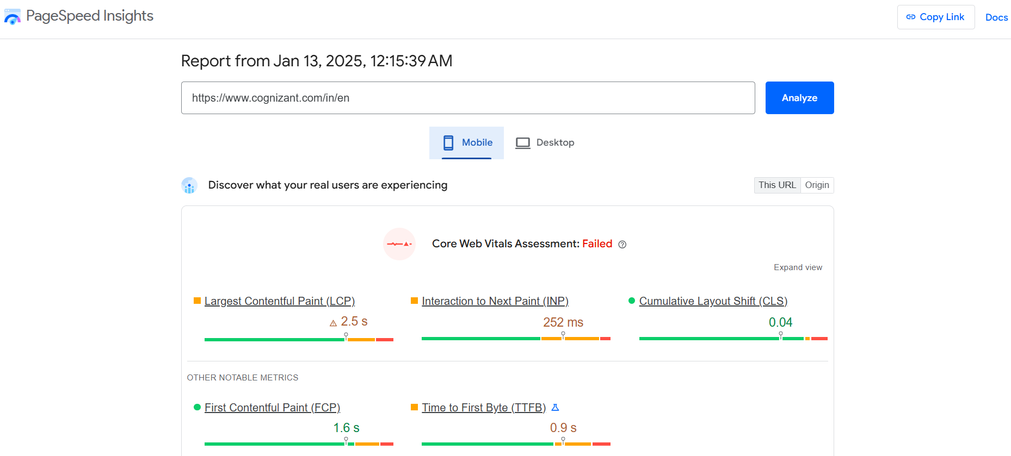
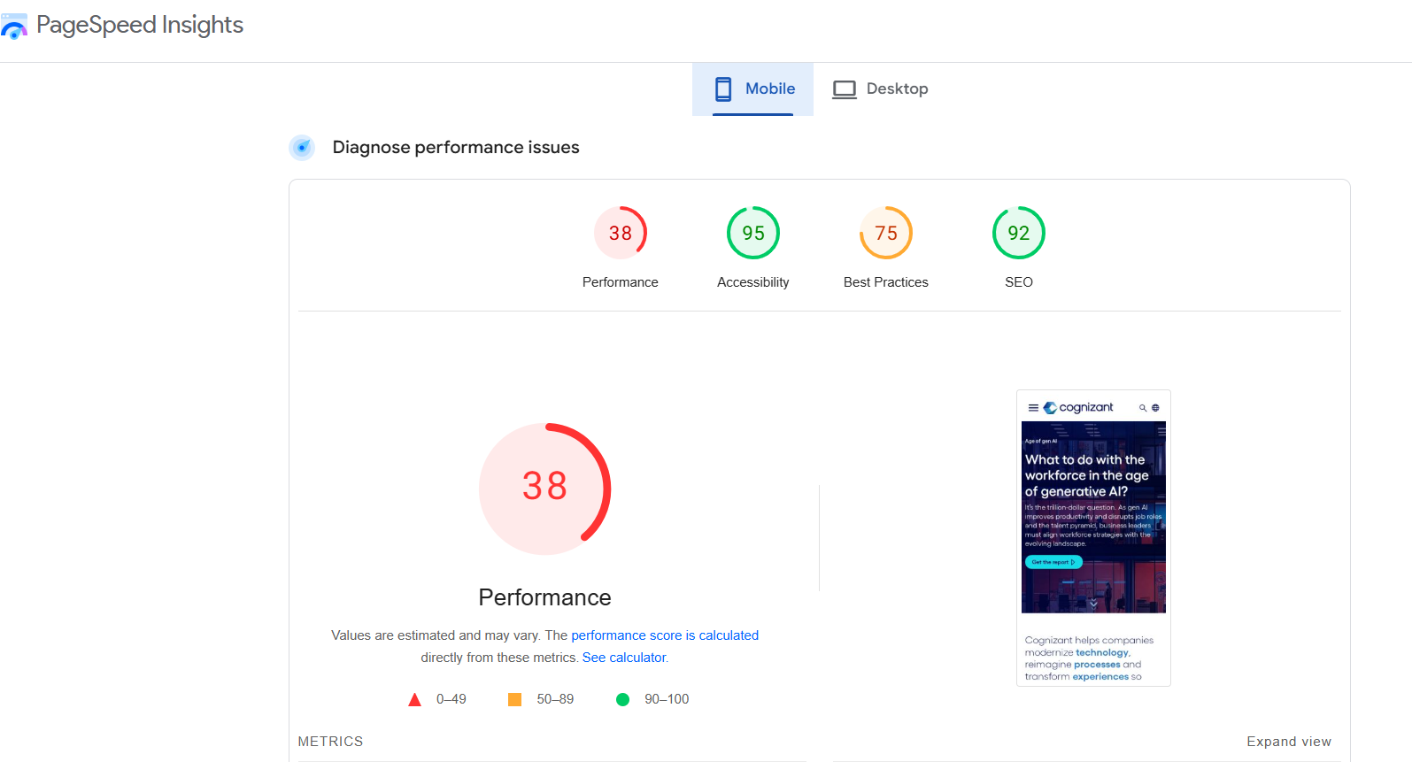
Task 1- initial audit:
Current Performance in mobile:
I optimize the current performance for the cognizant company (https://www.cognizant.com/in/en) through the “page speed insights” tool.
The core web vitals Assessment is failed for mobile. So, the website is not properly optimized for mobile devices and the performance score also 38. So, the performance also not good for the website in mobile. Only good in performance score is more than 50.

Slide 7
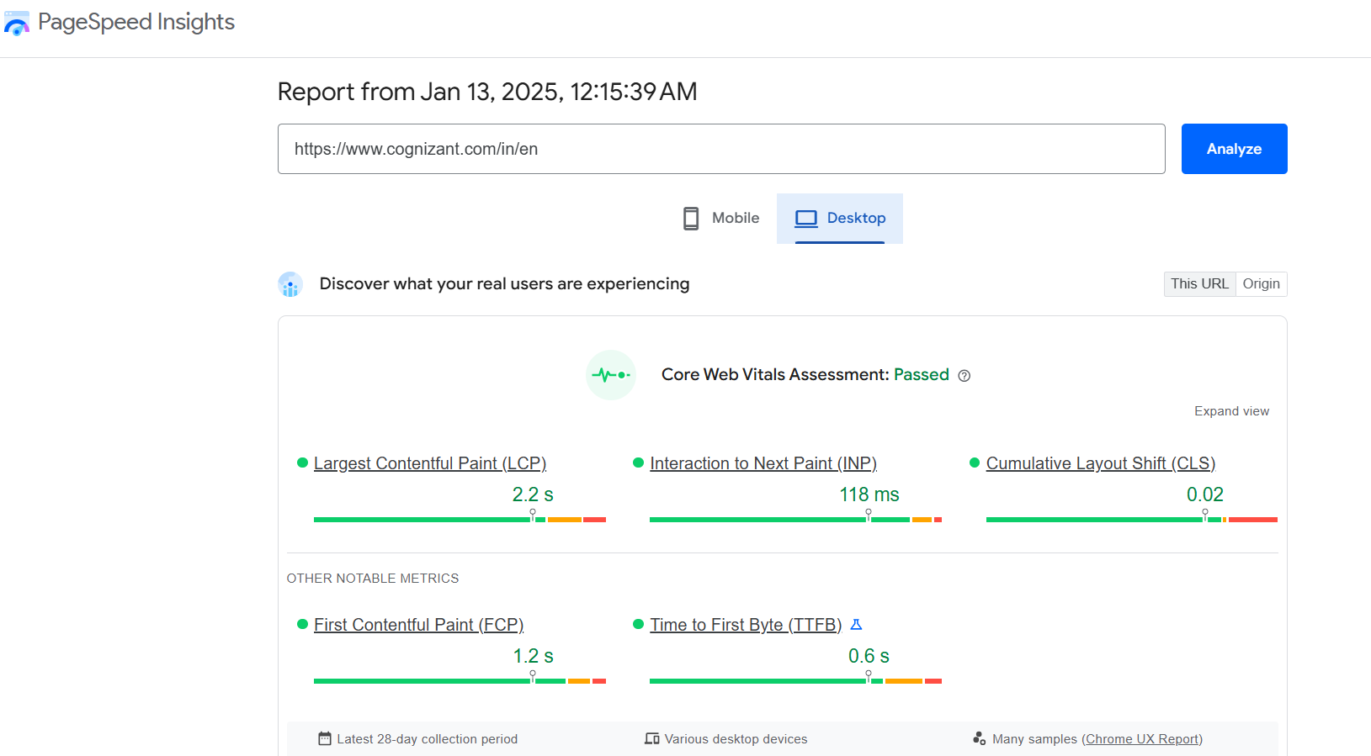
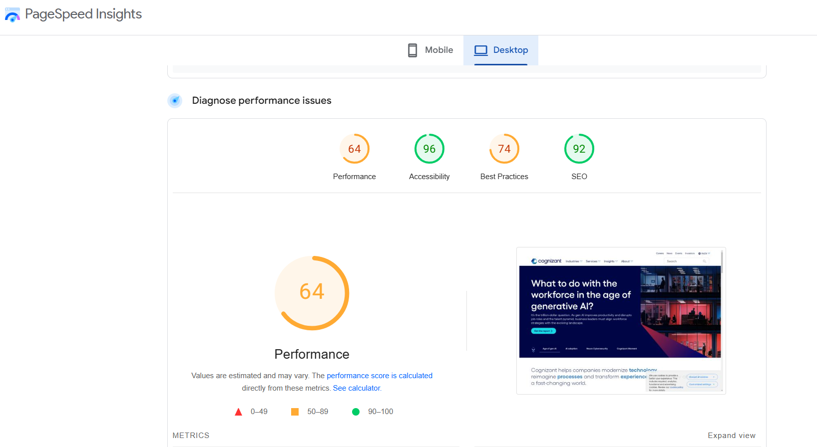
Current Performance in Desktop:
The core web vitals Assessment is passed for Desktop. So, the website is properly optimized for desktop devices and the performance score also 64. So, the performance is not good for the website in desktop. Only good in performance score is more than 80.

Slide 8
STRENGTHS:
User friendly Navigation
Responsive Design
Visual Appeal
Content Quality
Accessibility
WEAKNESS:
Search Functionality
Limited Interactivity
SEO Optimization
Limited Client Engagement Features

Slide 9
Task 2 - keyword research:
Targeted Keyword:
I am chosen the primary keyword “Generative AI” from the Cognizant website from the Data & AI services (https://www.cognizant.com/us/en/services/ai/generative-ai).
I have done keyword research and competitor analysis for the ‘Generative Ai’ in Google keyword planner tool (https://ads.google.com/intl/en_uk/home/tools/keyword-planner/).
Sl.No | Keywords | Search volume
1. | generative ai | 10K-100K
2. | stability ai | 1K-10K
3. | gen ai | 10K-100K
4. | midjourney art | 10K-100K
5. | nightcafe ai | 1K-10K

Slide 10
Competitive Analysis:
Market Landscape:
The SEO landscape for Generative AI services is competitive. Analyzing competitor websites will reveal additional keyword opportunities and content strategies.
Gen Ai and Midjourney Art keywords are two major competitor in India.
Targeted Segments determine whether competitors focus on B2B, B2C, or niche industries like healthcare, finance, gaming, etc.
Product Features and Capabilities:
Core Functionality - Compare text, image, video, and code generation capabilities.
Customization – Analyze ease of model fine tuning for specific use case.

Slide 11
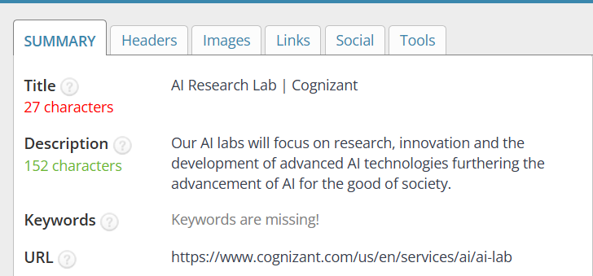
Task 3 – on- page seo optimization audit:
1st webpage : https://www.cognizant.com/us/en/services/ai/ai-lab
Targeted Keyword : AI Research Lab
Title is not properly optimized because it contains 27 characters only and Meta description also not properly optimized with the targeted keyword and HTML Tags are also not optimized properly in H1 , H2 tag with the targeted keyword.

Slide 12
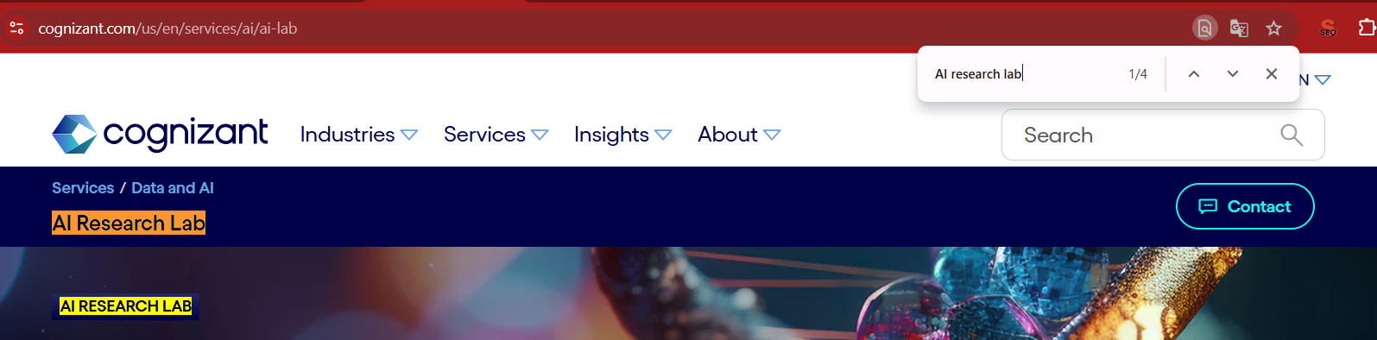
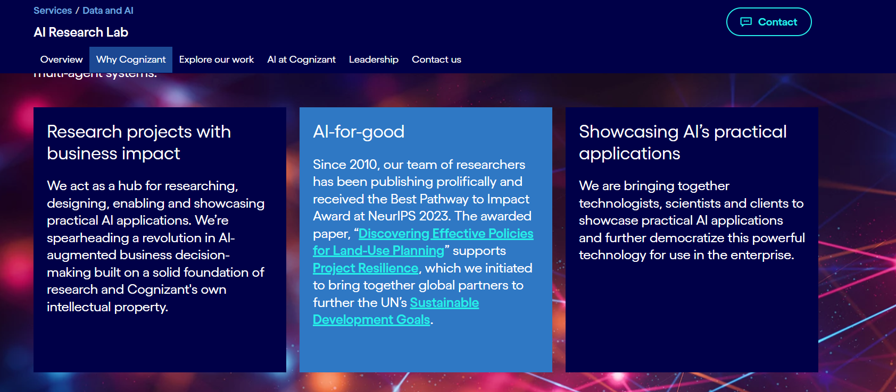
2. Keywords are properly optimized in content and Headings and used 4 times.
3. This page is not done internal linking and have done one external linking.

Slide 13
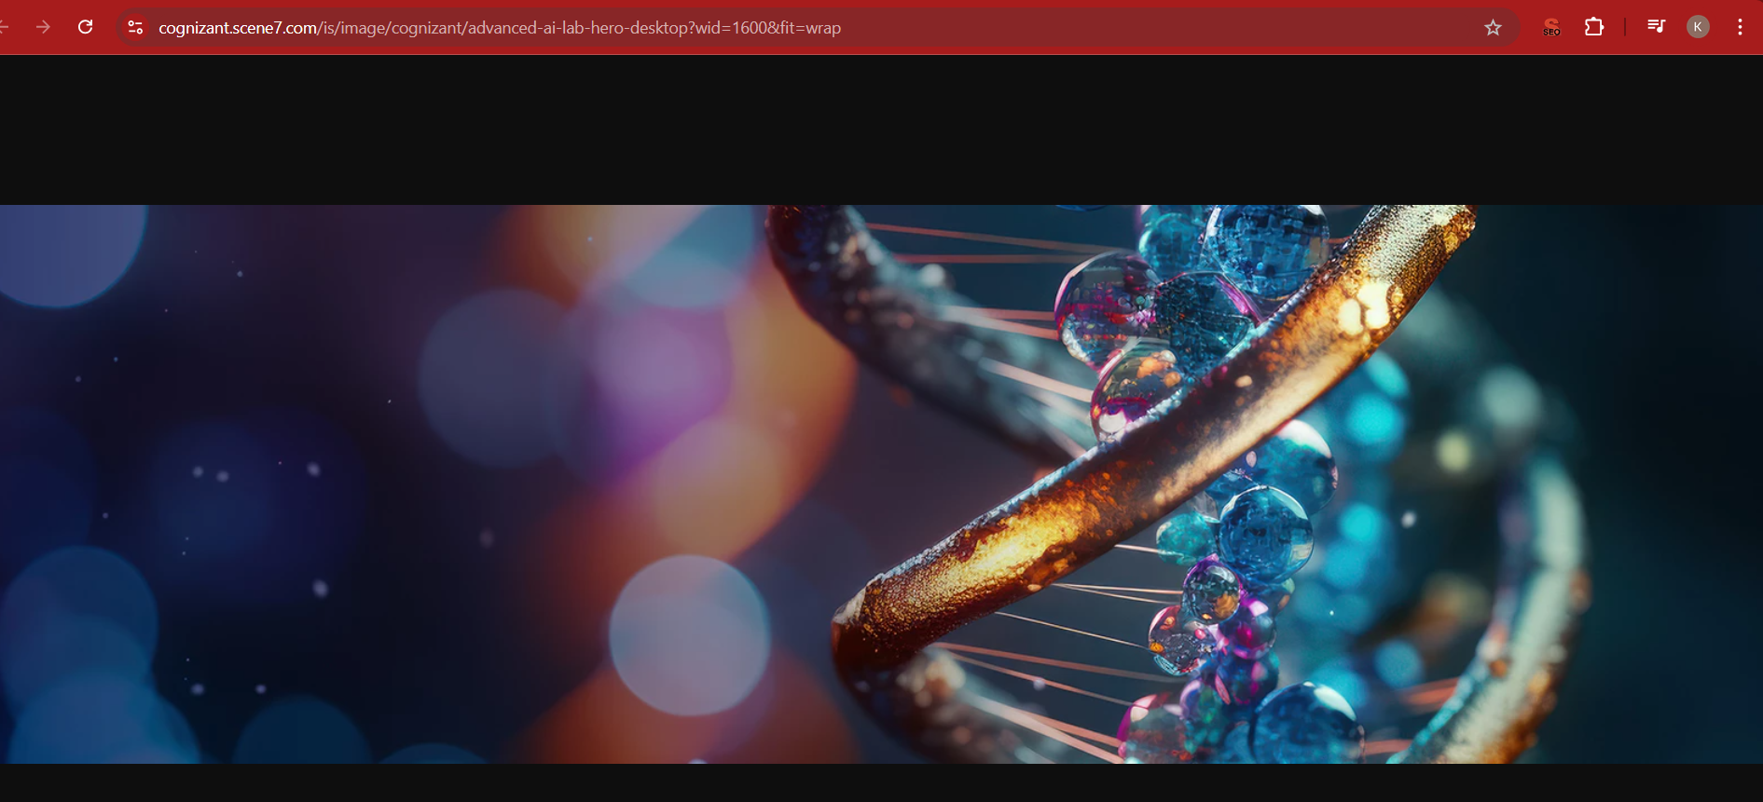
4. Images are optimized properly in this page.
Link for the image : ( https://cognizant.scene7.com/is/image/cognizant/advanced-ai-lab-hero-desktop?wid=1600&fit=wrap )

Slide 14
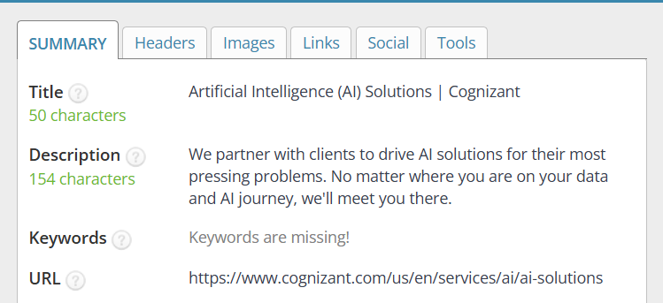
2nd webpage : https://www.cognizant.com/us/en/services/ai/ai-solutions
Targeted Keyword : Artificial Intelligence.
Title is optimized properly with the targeted keyword and Meta description are not properly optimized with the targeted keyword and HTML Tags are optimized properly in H1 , H2 tag with the targeted keyword.

Slide 15
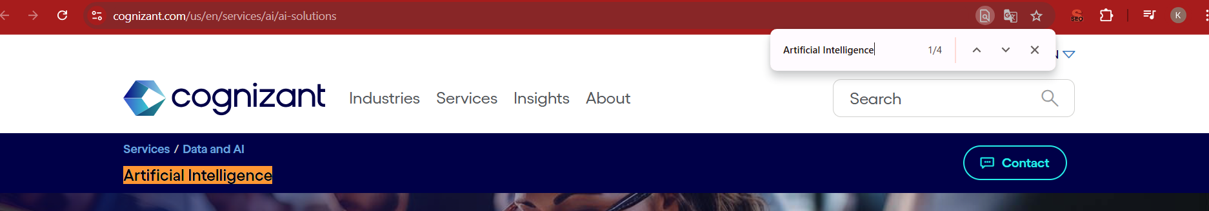
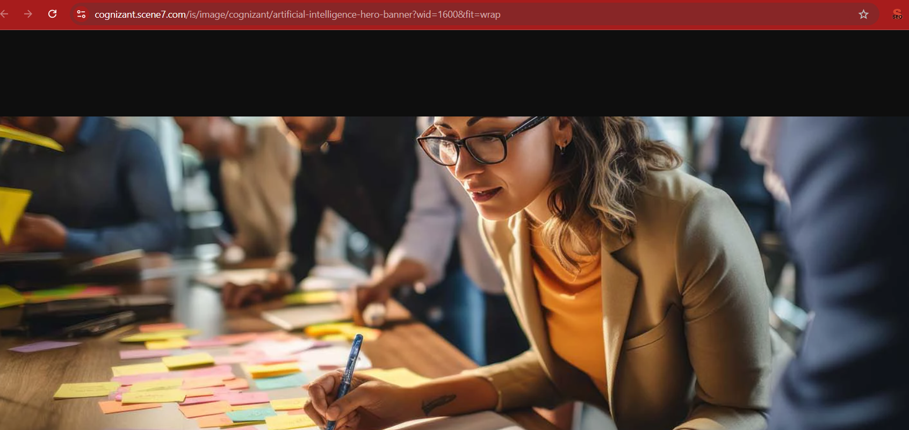
2. Keywords are properly optimized in content and Headings and used 4 times.
3. This page is not done internal linking and external linking.
4. Images are optimized properly in this page.
Link for the image : (https://cognizant.scene7.com/is/image/cognizant/artificial-intelligence-hero-banner?wid=1600&fit=wrap )

Slide 16
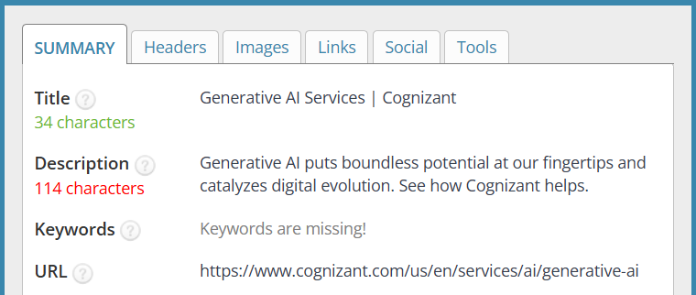
3rd webpage : https://www.cognizant.com/us/en/services/ai/generative-ai
Targeted Keyword : Generative AI
Title is optimized properly and Meta description is not optimized properly because it contains 114 characters only and HTML Tags are not optimized properly in H1 , H2 tag with the targeted keyword.

Slide 17
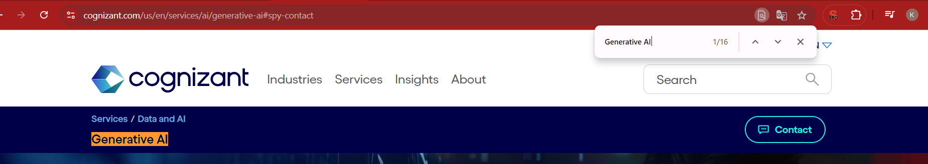
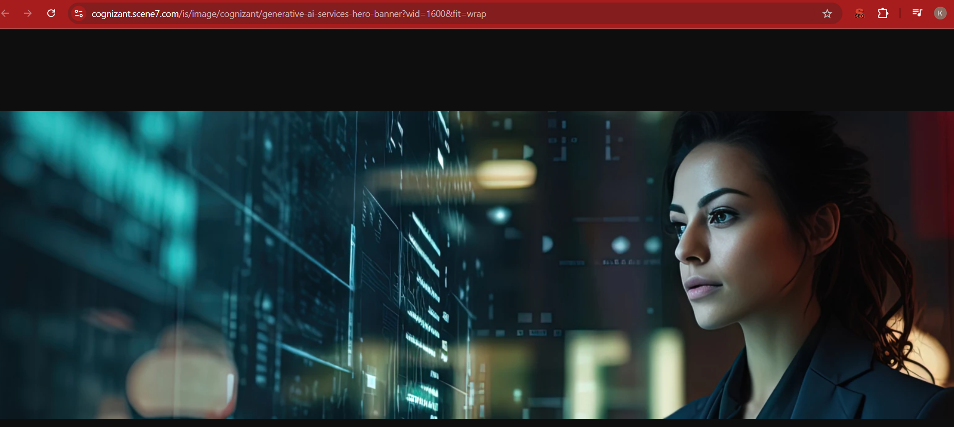
2. Keywords are not properly optimized in content and Headings and used 16 times. So, the page done with keyword stuffing.
3. This page is not done internal linking and external linking.
4. Images are optimized properly in this page.
Link for the image : (https://cognizant.scene7.com/is/image/cognizant/generative-ai-services-hero-banner?wid=1600&fit=wrap )

Slide 18
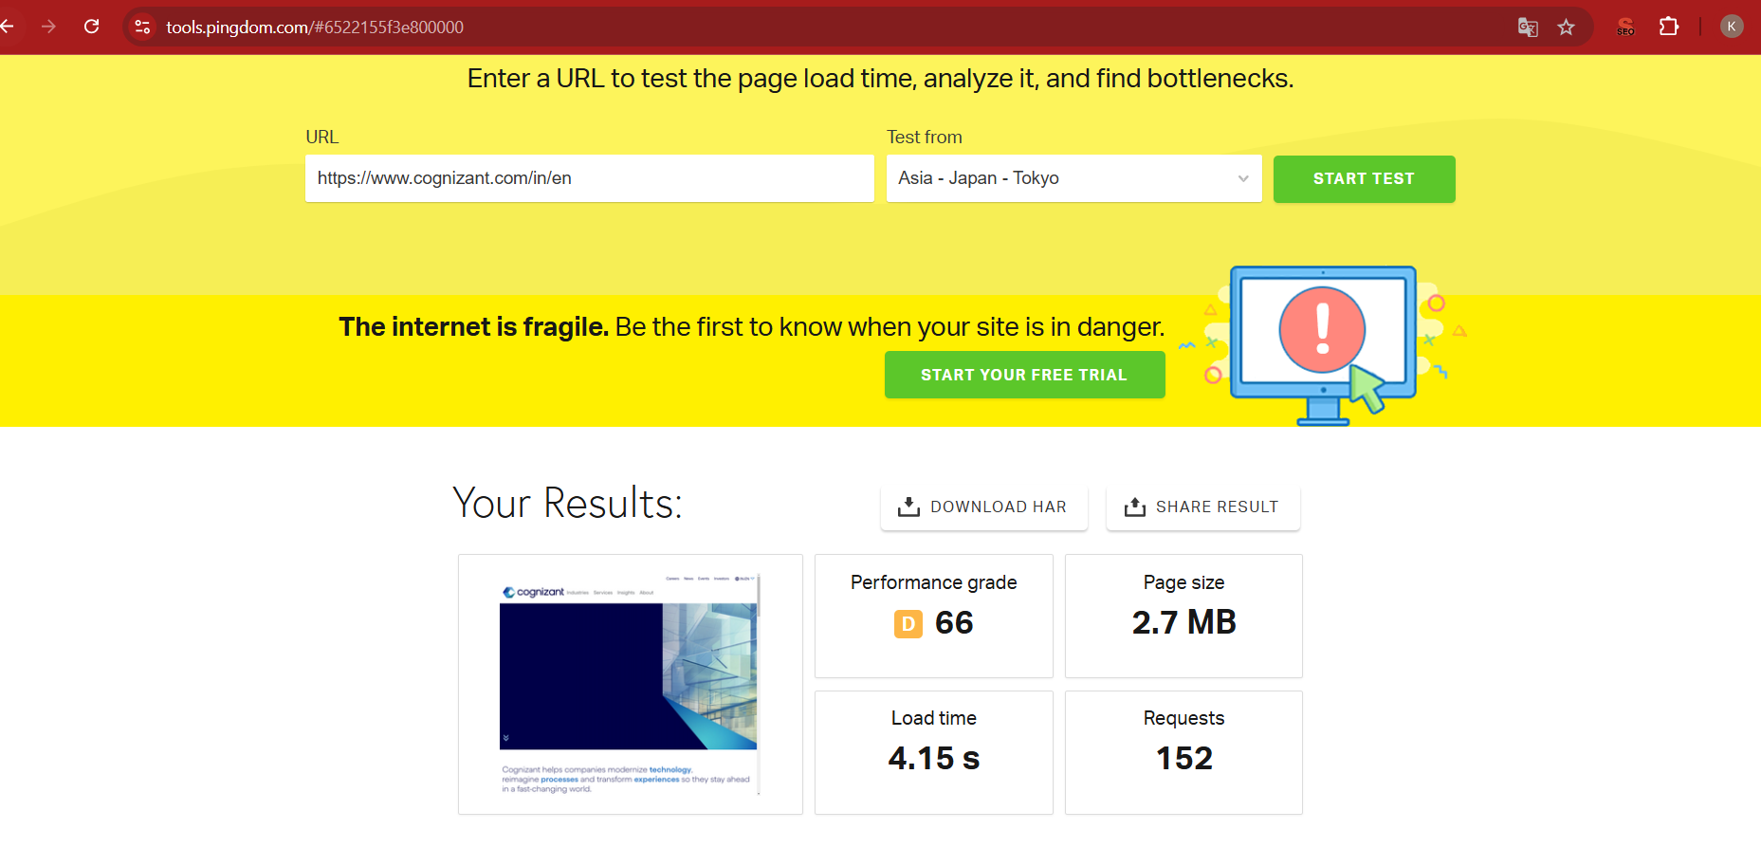
Task 4 – Technical seo
I have been done this Technical SEO research through using the “Pingdom website speed Test” ( https://tools.pingdom.com/ ).
Website Homepage (https://www.cognizant.com/in/en ) :
1. Technical SEO issues :
Missing Information :
Detailed Service Offerings.
Client Testimonials and Case studies.
Strengths :
The webpage load time speed is 4.15 Seconds is good and optimized properly.
Weakness:
Limited Localization.
Weak of Career Information.

Slide 19
5 Best Practices to Improve Site and Web Page Speed:
Optimize Images.
Enhance Page Load Speed.
Reduce Java script Execution.
Minimize Redirects.
Enhance Mobile Optimization.

Slide 20
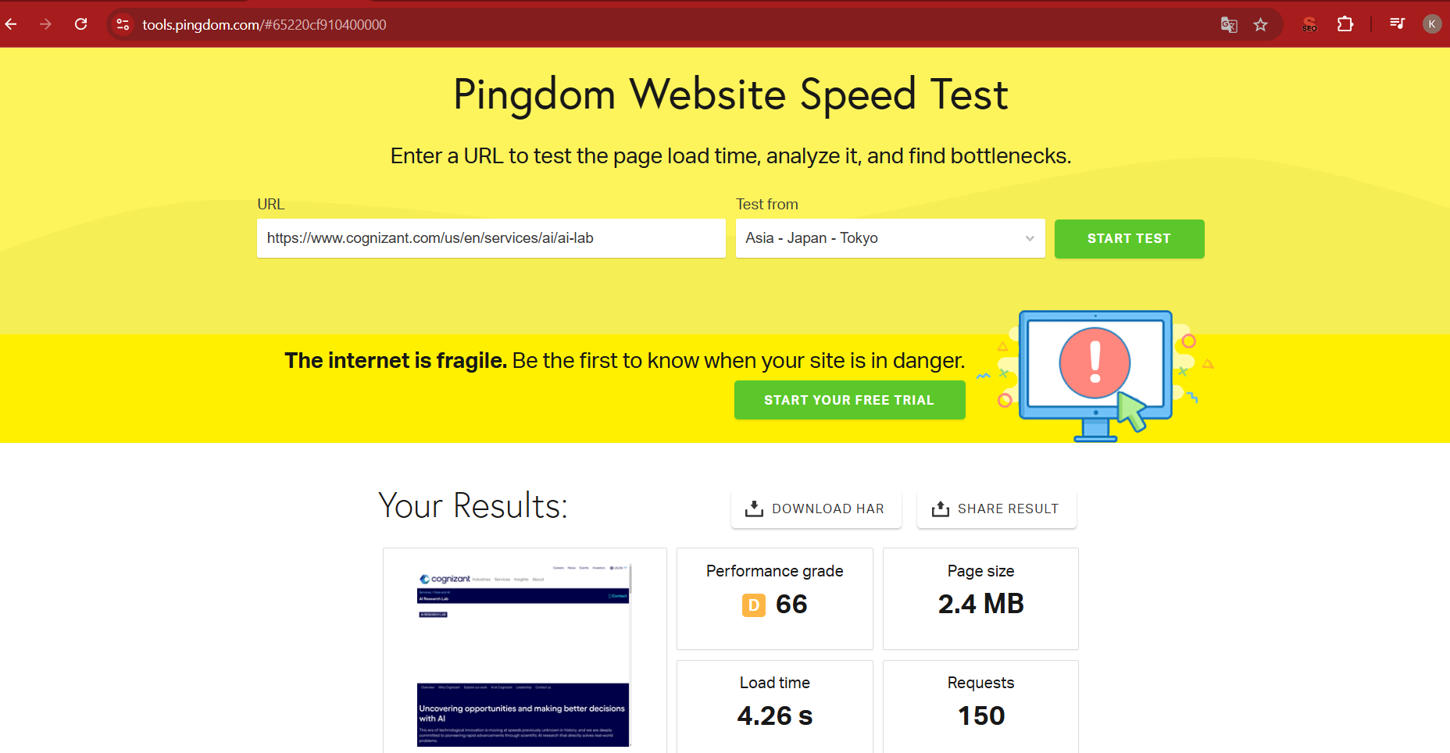
1st webpage : https://www.cognizant.com/us/en/services/ai/ai-lab
1. Technical SEO issues :
Missing Information :
Lack specific details about services.
Target audience clarity.
Strengths :
The webpage load time speed is 4.26 Seconds is good and optimized properly.
Weakness:
Minimal visual Appeal.
Mobile optimization Issues.

Slide 21
5 Best Practices to Improve Site and Web Page Speed:
Reduce DNS Lookups.
Make fewer HTTP requests.
Use Cookie free domains.
Avoid URL redirects.
Minify and compress code.

Slide 22
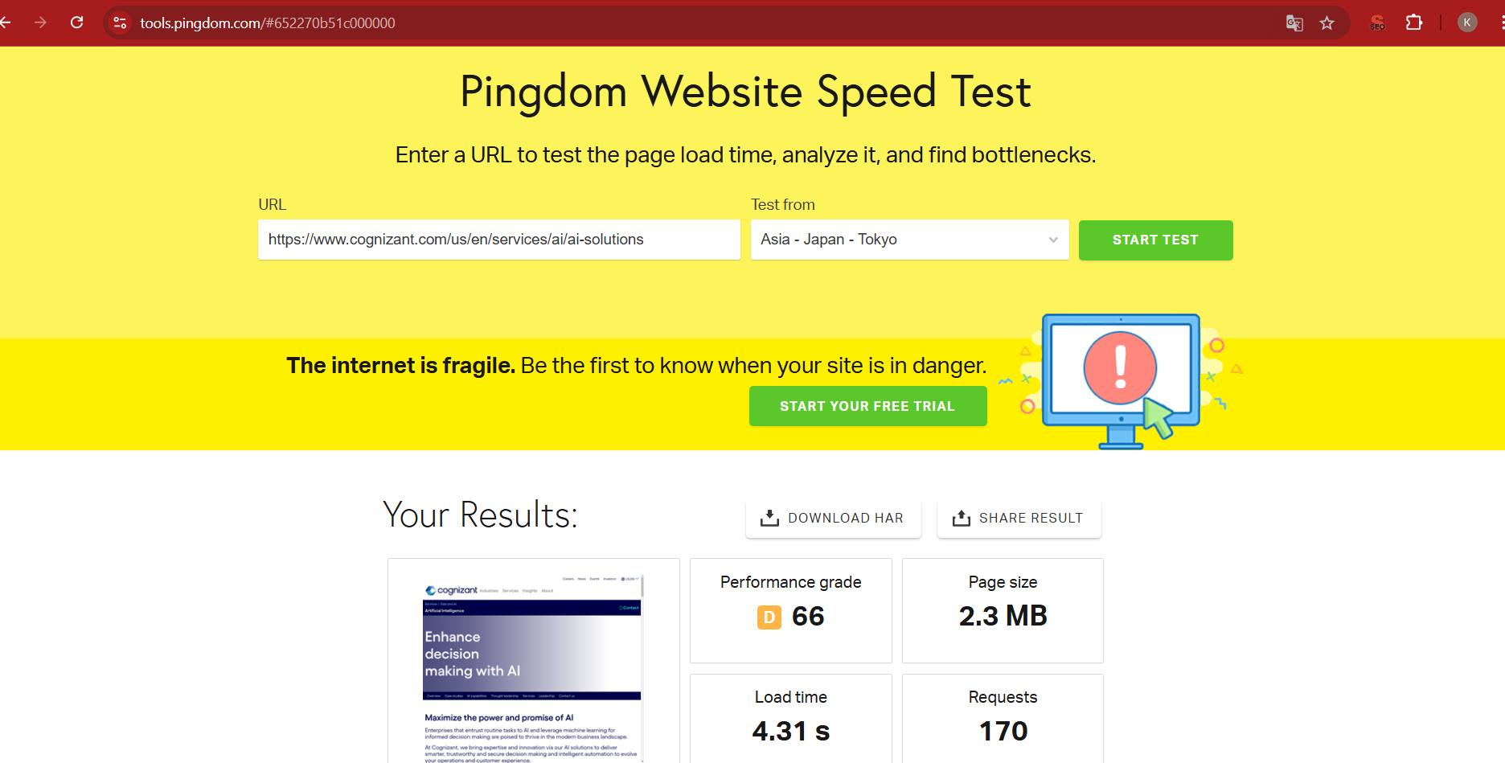
2nd Webpage : https://www.cognizant.com/us/en/services/ai/ai-solutions
1. Technical SEO issues :
Missing Information :
Thought Leadership content.
Interactive Features.
Strengths :
The webpage load time speed is 4.31 Seconds is good and optimized properly.
Weakness:
Poor SEO Optimization.
Limited Contact and Support Options.

Slide 23
5 Best Practices to Improve Site and Web Page Speed:
Optimize page load speed.
Improve core web vitals.
Minimize third party scripts.
Optimize Fonts.
Use preloading and prefetching.

Slide 24
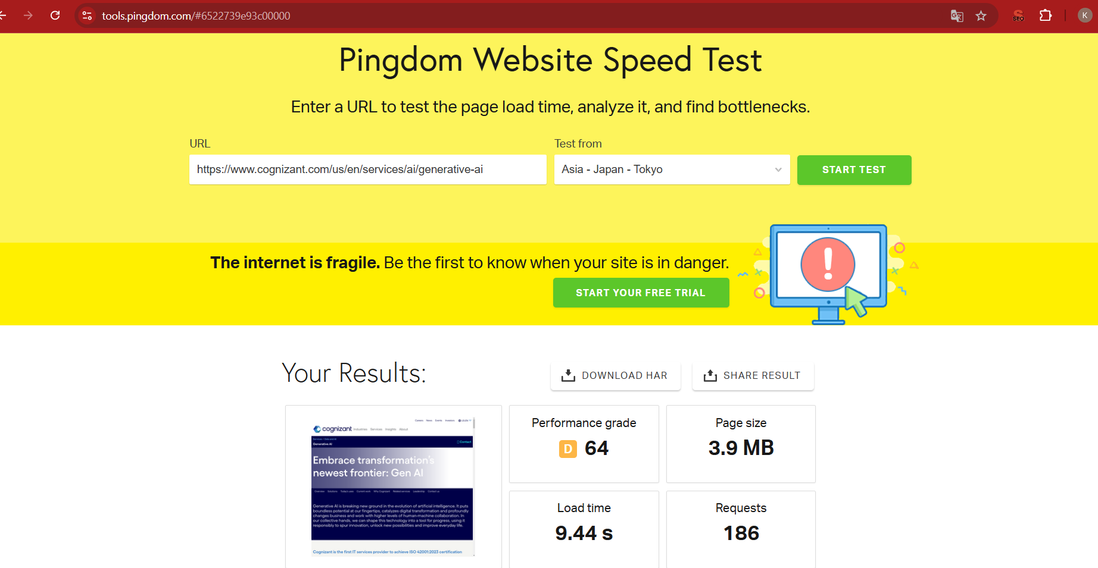
3rd webpage : https://www.cognizant.com/us/en/services/ai/generative-ai
1. Technical SEO issues :
Missing Information :
Specific Use Cases.
Ethical AI Practices.
Strengths :
The webpage load time speed is 9.44 Seconds is not good and not optimized properly because less than 5 seconds is good webpage load time speed.
Weakness:
Minimal Technical Transparency
SEO Limitations.

Slide 25
5 Best Practices to Improve Site and Web Page Speed:
Regular Monitoring anfd Testing.
Reduce Redirects.
Optimize java script and CSS
Improve Accessibility.
Improve SEO and Content Structure.

Slide 26
Task 5 – content strategy
1. Keyword : Generative AI
Blog Topic : “The ROI of Generative AI: Is It Worth the Investment?”
2. Keyword : Stability AI
Blog Topic : “Optimizing AI for Stability: Challenges and Solutions in Model Training”
3. Keyword : Gen AI
Blog Topic : “The Future of Gen AI: Trends to Watch in 2025 and Beyond”
4. Keyword : Midjourney Art
Blog Topic : “Midjourney vs. Other AI Art Tools: What Sets It Apart?”
5. Keyword : Night cafe AI
Blog Topic : “Exploring Night Cafe AI's Compatibility with Other Creative Tools”

Slide 27
Task 6 – off-page seo
1.Link Building Strategy :
High Quality Backlinks.
Competitor Backlink Analysis.
2. Content Marketing Strategy :
Publish High-Quality Content.
Infographics and Visual Content.
3. Social Media Engagement:
Leverage Social Platforms
Social Sharing Buttons

Slide 28
4. Community Building and Forums :
Host Webinars and Events.
Build a LinkedIn Community.
5. Influencer Marketing :
Partner with Influencers.
Employee Advocacy as Influencers.
6. Reviews and Testimonials :
Encourage Client Reviews.
Respond to Reviews.
7. Local SEO and Events :
Optimize for Local Directories.
Google My Business.

Slide 29
conclusion
In conclusion, the comprehensive SEO audit and optimization for Cognizant's India website lays the foundation for enhanced organic traffic growth and improved online visibility. By addressing on-page, off-page, and technical SEO gaps, the strategy ensures a user-friendly experience while aligning with search engine best practices. With consistent efforts in content creation, link building, and performance monitoring, the website is poised to achieve sustainable growth, strengthen its authority in the digital consulting space , and effectively reach its target audience.

Slide 30
Thank you…

